Slide 1
Chiba Campaign Daily Report
2022 12/4
B3 Shunya Mizobuchi
Notes:
顧さんは？
1

Slide 2
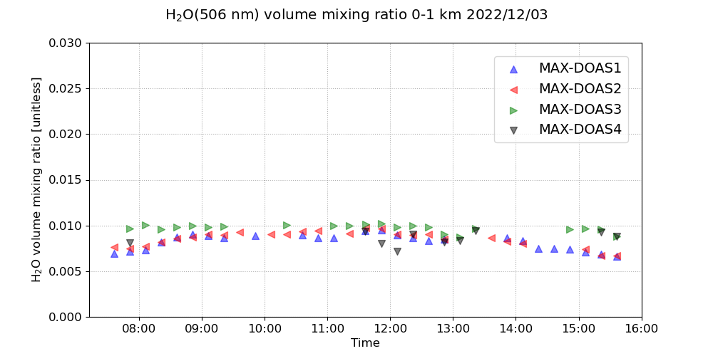
H₂O volume mixing ratio(4 Directions)

Slide 3
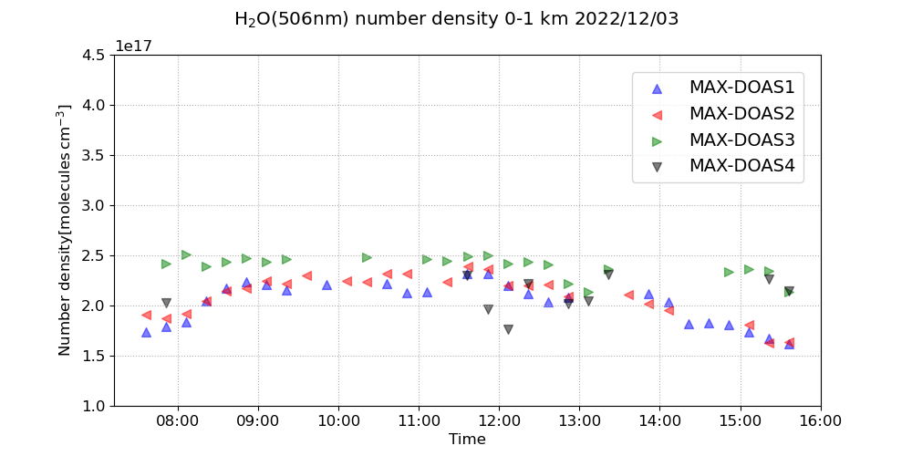
H₂O number density(4 Directions)

Slide 4
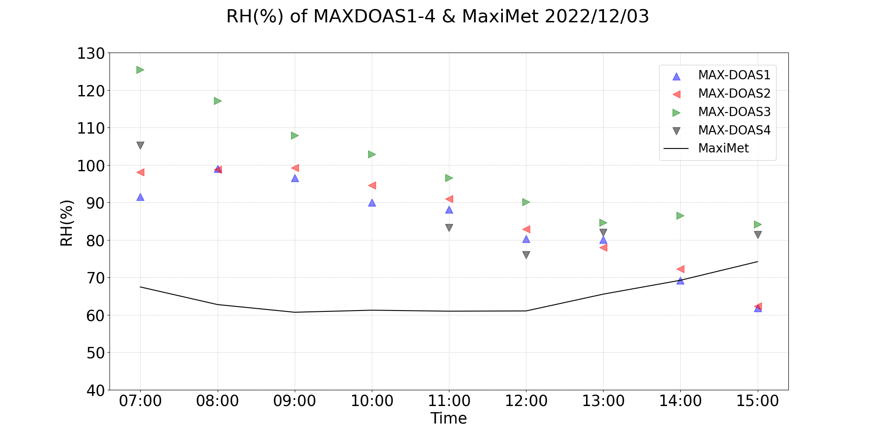
Comparison of RH between MAX-DOAS and Maximet

Slide 5
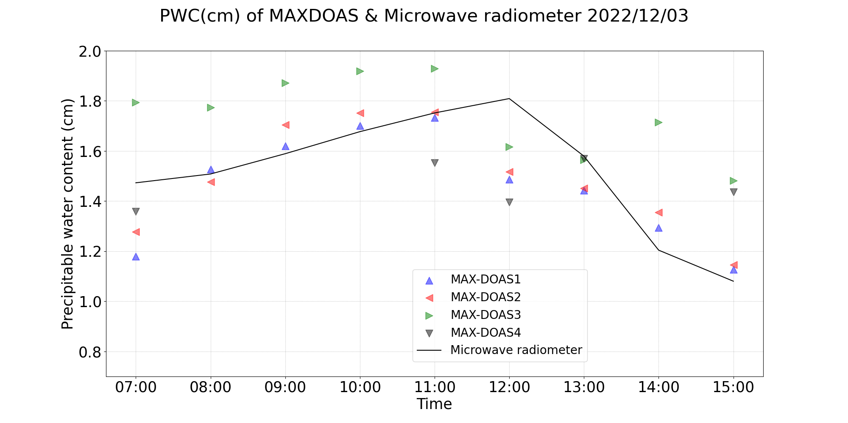
Comparison of PWC between MAX-DOAS and MWR

Slide 6
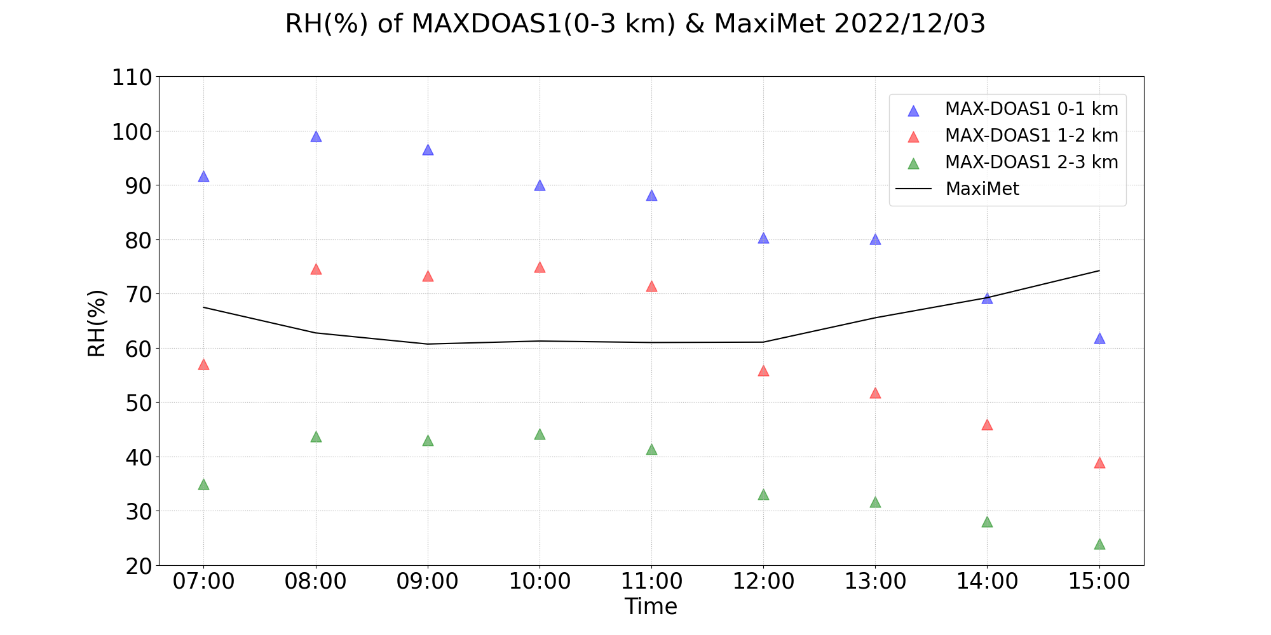
Comparison of RH between MAX-DOAS(0-3 km) and Maximet

